Slide 1
Defining System Connectivity with
Harness Design in Altium
Krishna Sundaram
15th April 2024

Slide 2
Tackle Any Design Complexity
Electronic designs come in various levels of complexity, from simple to intricate. And when you factor in challenges like flexible designs and multi-board setups, the complexities you’re already working through only become more difficult.
Altium Designer is a complete solution designed for the entire spectrum of PCB projects, from a basic circuit to a full avionics system. With the right tools for managing design rules, advanced routing, and designing on 3D surfaces, your team can work efficiently and avoid extra costs no matter how complex the project is.
Notes:
The realm of electronic design encompasses a spectrum of complexities, from straightforward circuits to intricate systems, often compounded by challenges like flexible designs and multi-board configurations.
Altium Designer serves as a comprehensive solution tailored for this diversity, catering to projects ranging from basic circuitry to full-scale avionics systems. Equipped with robust tools for managing design rules, advanced routing capabilities, and the ability to work seamlessly on 3D surfaces, Altium Designer empowers teams to navigate projects efficiently while mitigating potential cost overruns.

Slide 3
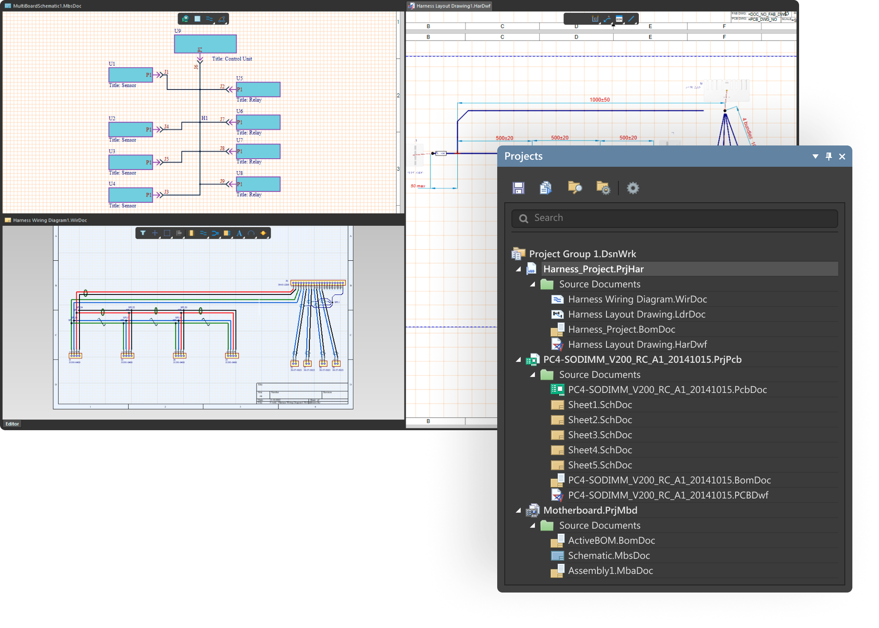
Harness Design
PRO
ENT
Harness design involves creating and optimizing the layout and configuration of electrical wiring systems within Altium Designer to efficiently arrange wires, connectors, and components to achieve a clean and organized electrical system.
Create and synchronize multi-board systems and the electrical harnesses connecting them in one platform
Prevent costly manufacturing errors with automated design checks when working on complex harnesses
Easily create harness documentation drawings
Automatically generate your complete harness bill of materials
Notes:
Harness design within Altium Designer involves the meticulous layout and optimization of electrical wiring systems to efficiently arrange wires, connectors, and components, ultimately achieving a clean and organized electrical system.
One of its key capabilities is the creation and synchronization of multi-board systems and the electrical harnesses connecting them, all within a unified platform. This integration simplifies the design process and ensures seamless connectivity between various components.
To mitigate the risk of costly manufacturing errors, Altium Designer offers automated design checks specifically tailored for complex harnesses. These checks help identify potential errors early in the design phase, minimizing the likelihood of issues during manufacturing.
Additionally, the software facilitates the creation of harness documentation drawings, making it easy for users to capture and communicate design details accurately. Furthermore, Altium Designer automates the generation of a complete harness bill of materials (BOM), streamlining the procurement process by compiling a comprehensive list of all required components.
Overall, Altium Designer provides a robust suite of tools and features for efficient harness design, ensuring accuracy, reliability, and cost-effectiveness throughout the design and manufacturing lifecycle.

Slide 4
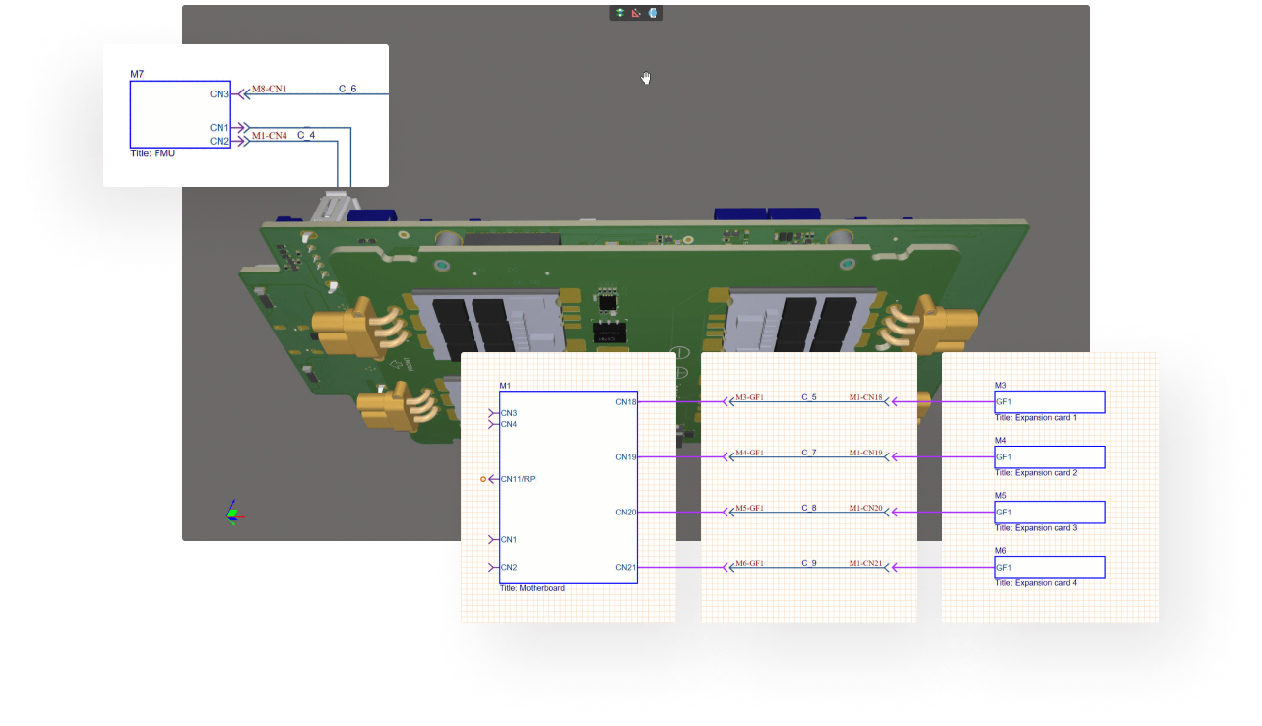
Designing as a System
Intuitively design multi-board systems complete with harnesses
Spend more time creating complex designs and less time learning how to integrate multiple boards in your design tools. With the same design approach and editors used for single-board designs, Altium Designer empowers designers of all levels to intuitively create interconnections between multiple boards. Plus, with harness design synchronization, you have everything you need to complete your multi-board projects.
Notes:
Designing electronic systems involves a shift towards a holistic approach, where components are not viewed in isolation but as integral parts of a unified system. Altium Designer facilitates this transition seamlessly, offering intuitive tools for designing multi-board systems, including the incorporation of harnesses for streamlined connectivity.
Traditionally, integrating multiple boards in design tools could be a daunting task, requiring significant time and expertise. Altium Designer revolutionizes this process by providing a familiar design environment similar to single-board design workflows. This approach ensures that all skill levels can easily adapt to designing multi-board systems without the need for extensive retraining or learning curves.
By leveraging the same design approach and editors used for single-board designs, you can intuitively create interconnections between multiple boards. This means that you can spend more time focusing on the intricacies of your designs rather than grappling with the complexities of integration.
Moreover, Altium Designer offers harness design synchronization, a feature that streamlines the creation of harnesses essential for connecting various boards within the system. This synchronization capability ensures that changes made to the harness design are seamlessly integrated into the overall multi-board project, reducing the risk of errors and inconsistencies.
With Altium Designer, you have everything they need to complete multi-board projects efficiently and effectively. Whether it's creating complex designs or managing interconnections between boards, Altium Designer empowers you to unleash your creativity and bring your innovative ideas to life without being hindered by the challenges of multi-board design integration.

Slide 5
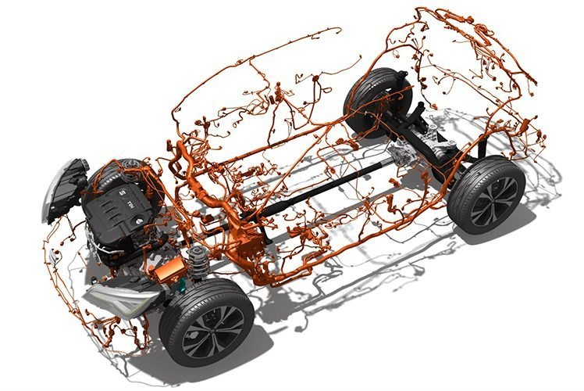
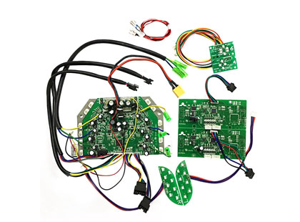
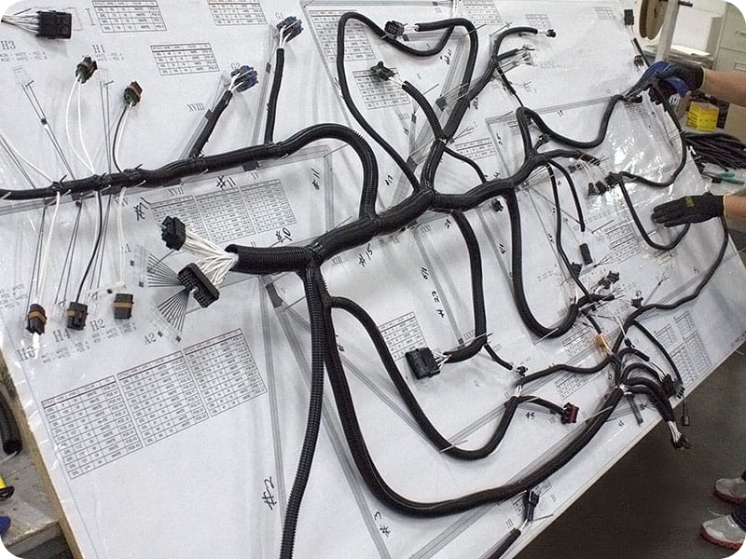
Harness Design: Why?
Why Did Altium Designer Introduce Harness Design?
We want to provide platform for complete product design
We did have multi-board but not a way to connect everything together
Now we have harness design to connect our multiple boards into an electronic system.

Slide 6
Harness Design: Benefits
What benefits do engineers get from this
Single Integrated Platform
Don’t need to learn/invest in a new tool
No Manual file transfers
PCB Synchronization - Connectivity is pushed to harness from multi-board project
Competitive Advantage
Integrated ecosystem without the need to manually upload files
Full product design in the same environment without needing third-party software
Time saving by working with a single cohesive data model that encompasses all the necessary information for complete system integration.
Traceability in design & minimizing the revision of the subsequent product design iterations by using a single integrated EDA tool.
Manufacturing cost reduction & improve reliability by having full definition within the multi-board environment.
Documentation - Single software that holds the complete product design data, enabling easier troubleshooting & navigation.
Synchronization with multi-board

Slide 7
Harness Design: How?
How are we doing it?
Project Creation
Standalone harness project
Part of a multi-board project
Can Bring in connectivity
New Harness Project Documents
Harness Wiring Diagram (*.WirDoc) – individual wires and cables are placed to create the required physical connections within the harness.
Harness Layout Drawing (*.LdrDoc) – the wires and cables are arranged to represent the physical construction of the harness.
Draftsman Document (*.HarDwf) – read-only views of the wiring diagram, layout drawing and BOM are imported, and any additional information required for the manufacturing of the harness is added.

Slide 8
Harness Design: Who can take advantage?
Companies that design Products consisting of electrical, electronics and mechanical elements, with emphasis on MCAD collaboration and harness design. Their products can be as small and simple as home appliances or as big and complex as communication satellites.
Engineers who design both electronics and harnesses with or without aid of Mechanical Engineers or Harness Engineers.

Slide 9
Demonstration

Slide 10
Questions?

